Slide 1
Grid Network Experiments 1
封钰震
2021/8/10

Slide 2
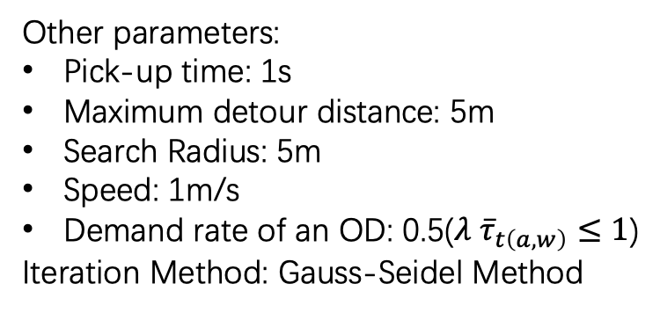
Time Consumed of Each Step
Network | OD | Taker | Match | Iteration | Step 0 / s | Step 1 / s
30*30 | 300 | 5056 | 32772 | 29 | 0.488 | 0.453
180*180 | 2000 | 191956 | 148530 | 20 | 108.342 | 4.285
180*180 | 1e4 | 9.5e5 | 3.6e6 | 25 | 2692.946 | 53.341
Other parameters:
Pick-up time: 1s
Maximum detour distance: 5m
Search Radius: 5m
Speed: 1m/s
Demand rate of an OD: 0.5($λ {\overline{τ}}_{t\left(a,w\right)}≤1$)
Iteration Method: Gauss-Seidel Method

Slide 4
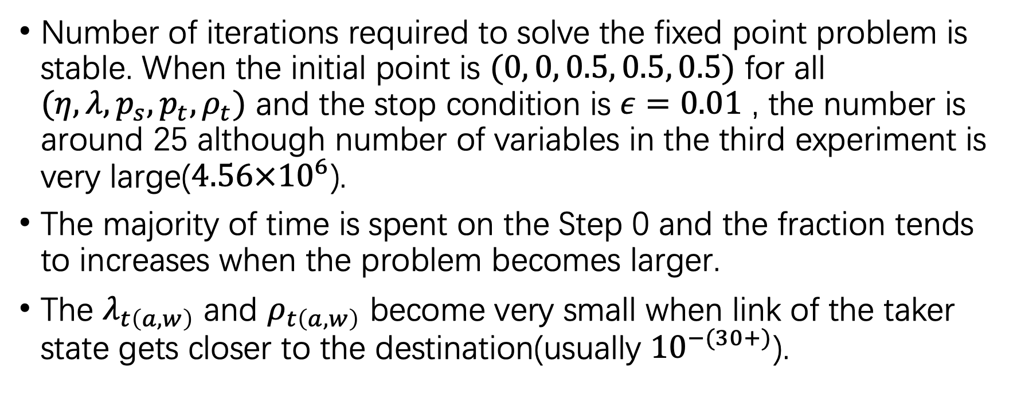
Phenomenon
Number of iterations required to solve the fixed point problem is stable. When the initial point is $(0, 0, 0.5, 0.5, 0.5)$ for all $(η, λ, p_{s}, p_{t}, ρ_{t})$ and the stop condition is $ε=0.01$ , the number is around 25 although number of variables in the third experiment is very large($4.56×{10}^{6}$).
The majority of time is spent on the Step 0 and the fraction tends to increases when the problem becomes larger.
The $λ_{t\left(a,w\right)}$ and $ρ_{t\left(a,w\right)}$ become very small when link of the taker state gets closer to the destination(usually ${10}^{−(30+)}$).

Slide 5
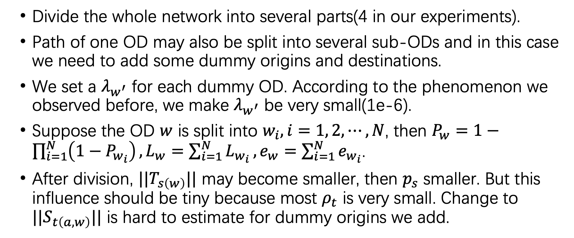
Divide and Combine
Divide the whole network into several parts(4 in our experiments).
Path of one OD may also be split into several sub-ODs and in this case we need to add some dummy origins and destinations.
We set a $λ_{w^{′}}$ for each dummy OD. According to the phenomenon we observed before, we make $λ_{w^{′}}$ be very small(1e-6).
Suppose the OD $w$ is split into $w_{i}, i=1, 2, ⋯, N$, then $P_{w}=1−\prod_{i=1}^{N}{\left(1−P_{w_{i}}\right)},L_{w}=\sum_{i=1}^{N}{L_{w_{i}}}, e_{w}=\sum_{i=1}^{N}{e_{w_{i}}}$.
After division, $||T_{s\left(w\right)}||$ may become smaller, then $p_{s}$ smaller. But this influence should be tiny because most $ρ_{t}$ is very small. Change to $||S_{t\left(a,w\right)}||$ is hard to estimate for dummy origins we add.

Slide 7
Phenomenon
Time of Step 0: 67.296 s
Time of Step 1: 6.533 s
Number of ALL iterations: 74
Number of variables:
Sub-network | OD | Taker | Match | Iteration
1 | 1059 | 52118 | 137129 | 19
2 | 980 | 46267 | 132703 | 19
3 | 1013 | 48968 | 129157 | 18
4 | 986 | 46641 | 120638 | 18
Total | 4038 | 193994 | 519627 | 74

Slide 9
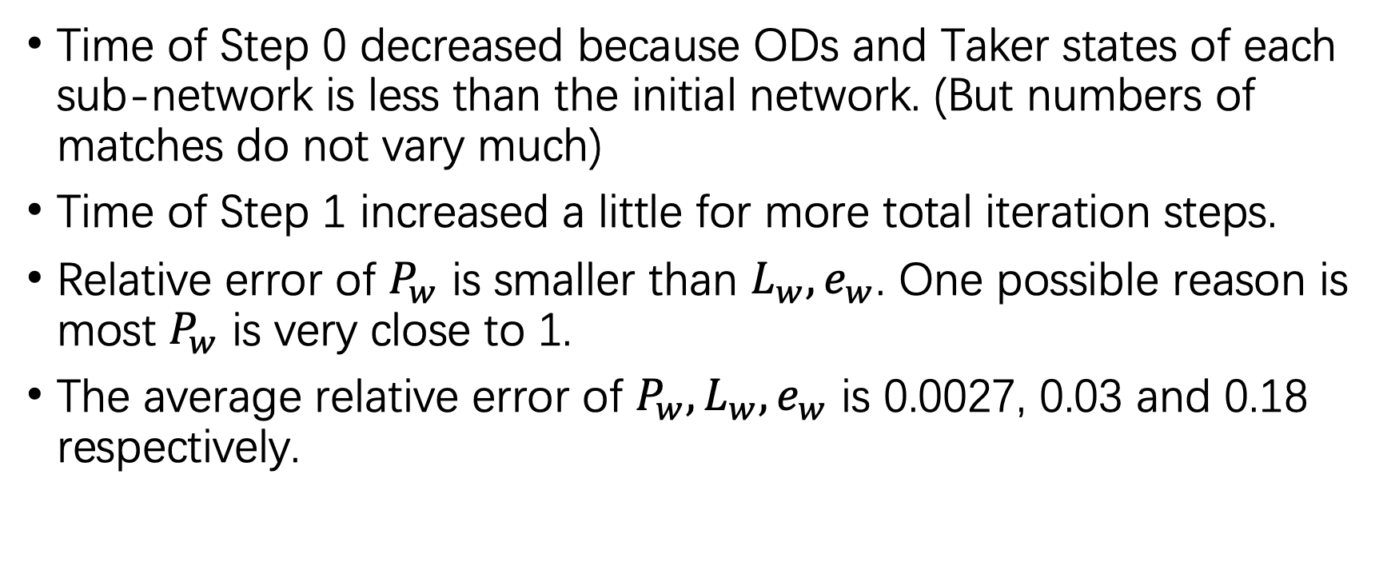
Phenomenon
Time of Step 0 decreased because ODs and Taker states of each sub-network is less than the initial network. (But numbers of matches do not vary much)
Time of Step 1 increased a little for more total iteration steps.
Relative error of $P_{w}$ is smaller than $L_{w}, e_{w}$. One possible reason is most $P_{w}$ is very close to 1.
The average relative error of $P_{w}, L_{w}, e_{w}$ is 0.0027, 0.03 and 0.18 respectively.

Slide 10
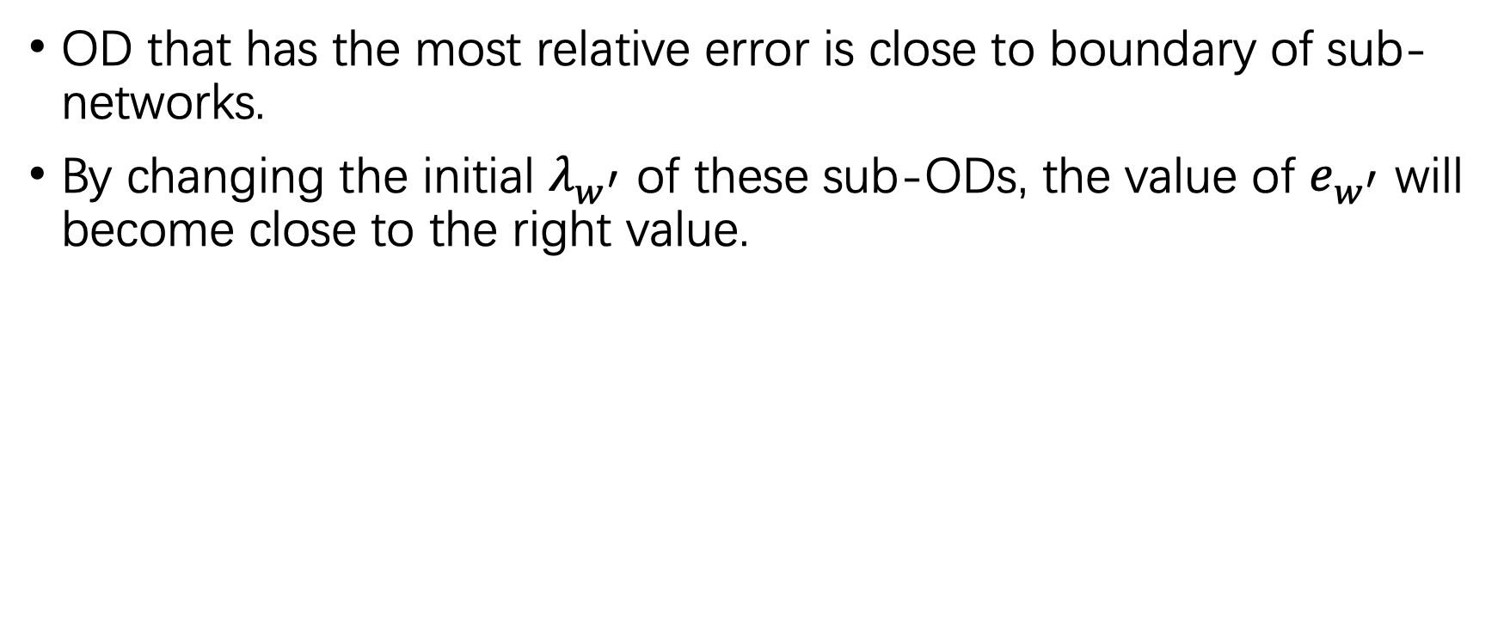
Phenomenon
OD that has the most relative error is close to boundary of sub-networks.
By changing the initial $λ_{w^{′}}$ of these sub-ODs, the value of $e_{w^{′}}$ will become close to the right value.

Slide 11
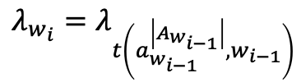
$$λ_{w_{i}}=λ_{t\left(a_{w_{i−1}}^{\left|A_{w_{i−1}}\right|},w_{i−1}\right)}$$

Slide 12
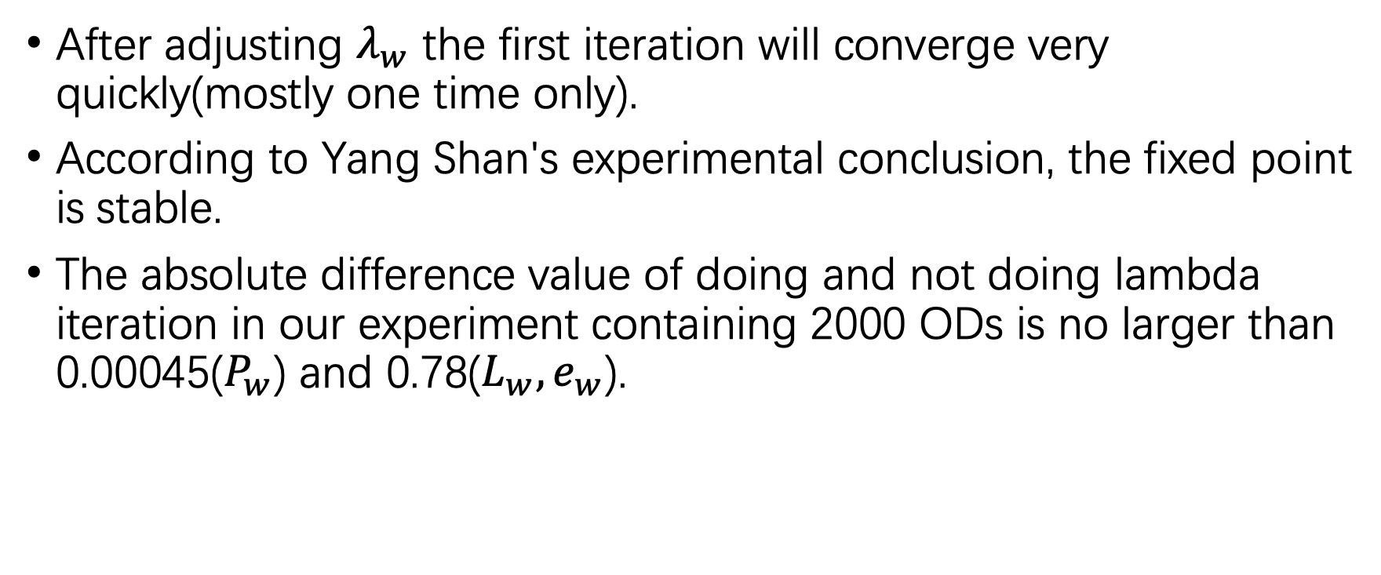
Result Analysis
After adjusting $λ_{w}$ the first iteration will converge very quickly(mostly one time only).
According to Yang Shan's experimental conclusion, the fixed point is stable.
The absolute difference value of doing and not doing lambda iteration in our experiment containing 2000 ODs is no larger than 0.00045($P_{w}$) and 0.78($L_{w}, e_{w}$).

